Slide 1
Team Project Ideation:
Crime Rate Mapping/ Neighborhood Platform
- CSC642 -
Group 10: Andre Lavilla, Tyler Fulinara, Marie Shimizu, William Chin, Leilah Lui

Slide 2

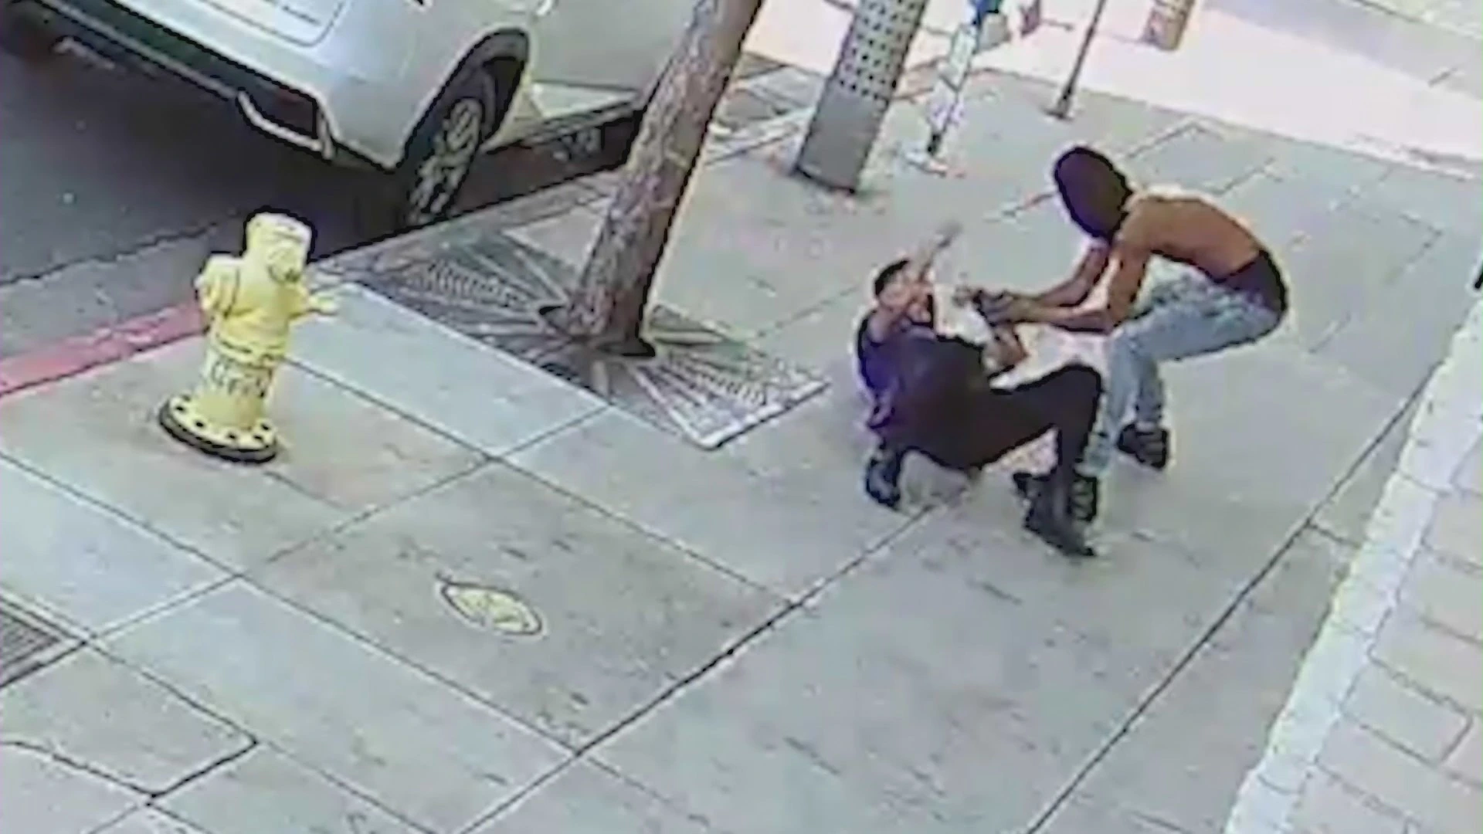
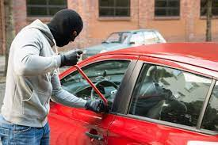
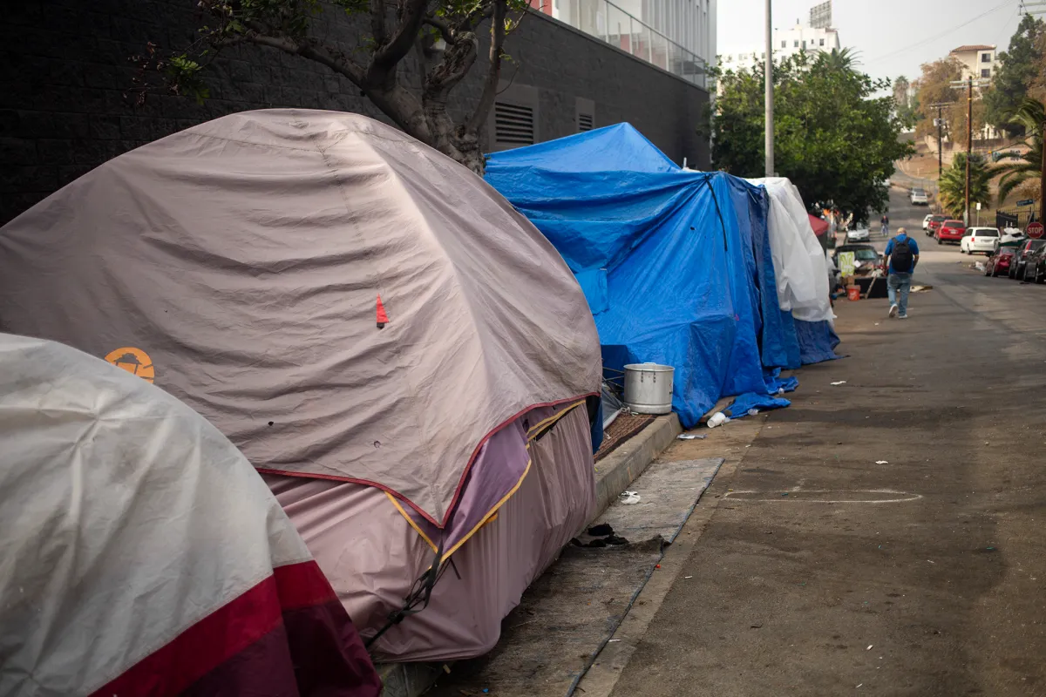

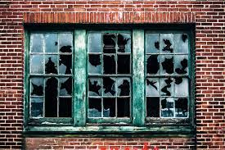
Do you feel safe in your neighborhood?
Notes:
In order for people or members of communities to care for one another, they must first feel safe. In places like San Francisco, there are areas with a wide range of crime rates. Those with higher crime rates are typical areas to avoid, especially if one is looking for housing, traveling and exploring, or simply out and about.

Slide 3
The Problem: Existing Tools are Inadequate
01
02
03
Not intuitive UI
Scattered Information
Outdated Data
Notes:
People have trouble locating and navigating around dangerous areas as current crime rate tools are inadequate, inaccurate and hard to use. If one finds themselves in an unsafe environment, they will naturally become defensive and less likely to “care” for others.

Slide 4
What do people want?
Accurate Information
Sense of Community
Everything in One Place

Slide 5
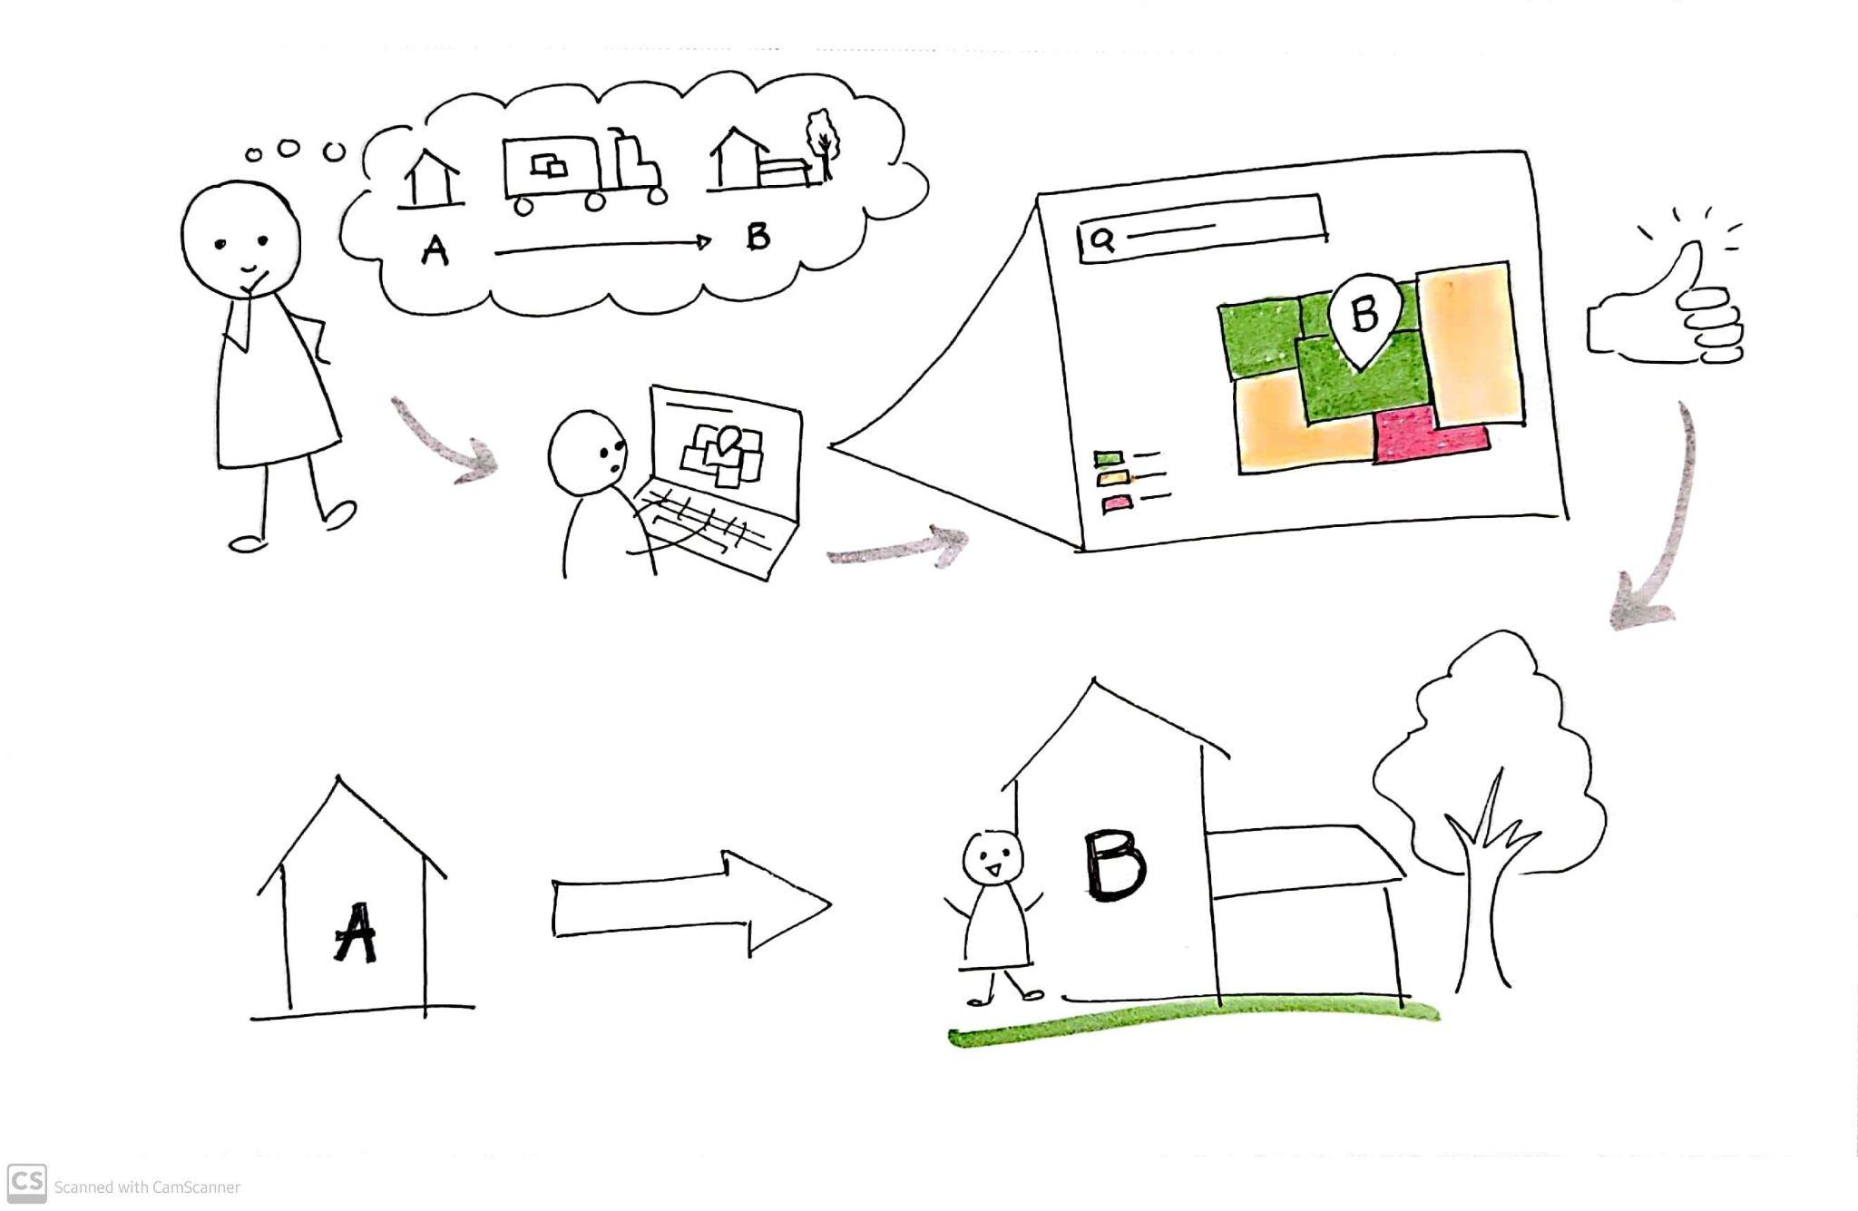
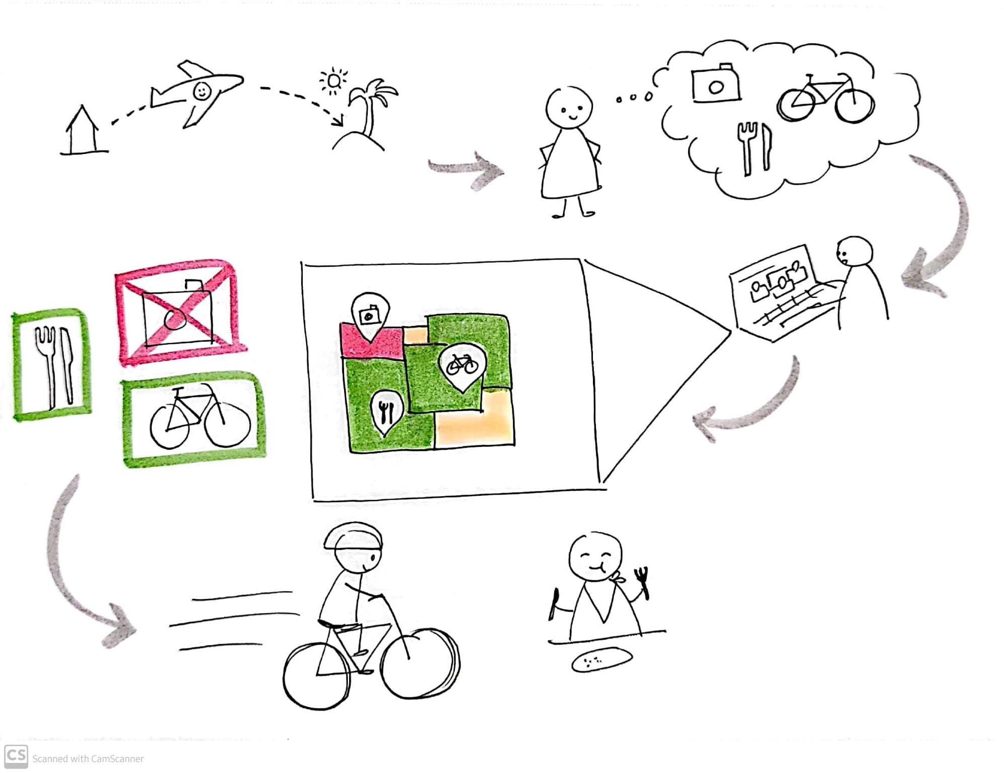
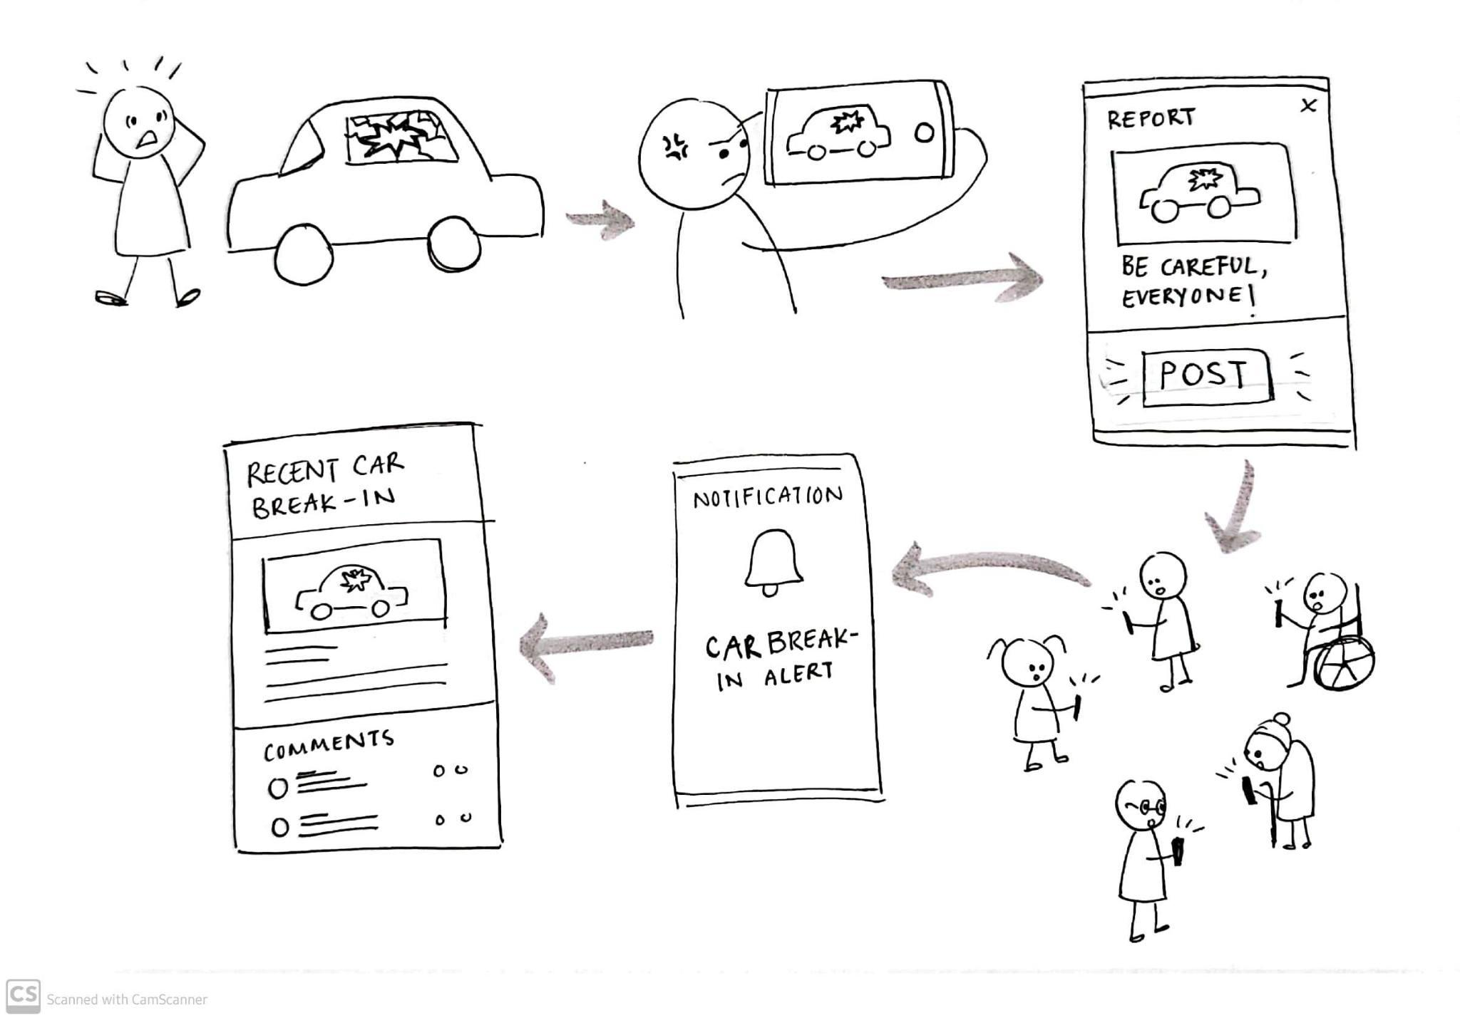
Initial Design Sketches & Storyboarding
Scenario 1: Looking for a new home
Scenario 2: Traveling/exploring new places
Scenario 3: Posting an incident
Notes:
Potential Use Case Storyboards:
Looking for a new home
Traveling
Reporting criminal activity/sighting/witnesses

Slide 6
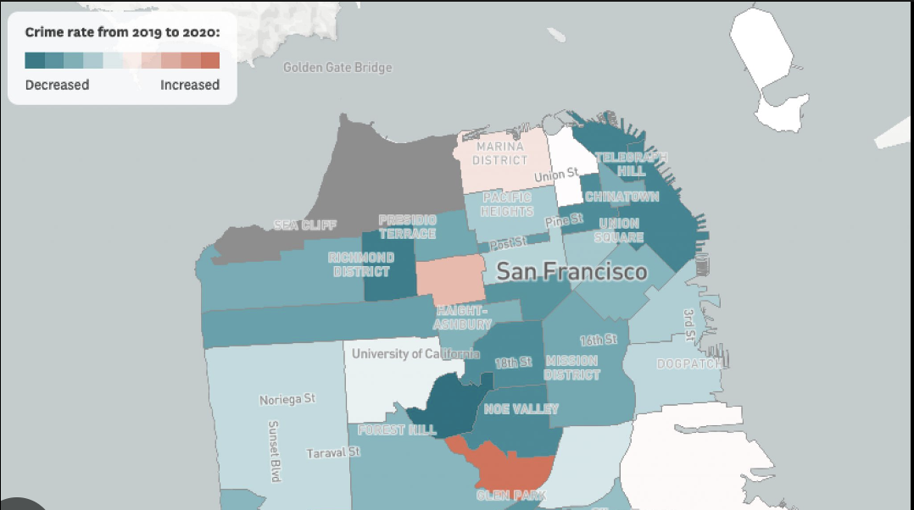
Our Solution:
A platform which…
Provides users an accessible, accurate, dynamic source of information, all in one place
Enables users to report/post about criminal activities
Builds a sense of community in the neighborhood and helps community members lead a more safe space
Has simple, intuitive UI/UX
Notes:
A platform that…
serves as an accessible, accurate, and dynamic source of information regarding criminal activity and crime rates in a certain location/area
enables users to report/post about criminal activity to notify community members and build a sense of community.
helps community members lead a more safe lifestyle and protect each other

Slide 7
Our Target Users:
People of All Ages
Members of Neighborhood
People who are Looking for a New Place
Home buyers/
Home owners
People who like to Travel, Explore etc.
Others like:
Police Officers/Law Enforcement
Home/Residential Construction Companies
City Councils
Travel Agencies
Homeless Shelters
Schools
Notes:
Primary Users:
People of all ages (that have a smart mobile device), genders, abilities, economic standings, races, etc.
Members of neighborhoods/communities (urban and suburban)
People who like to be outside, explore, and travel
People looking for a new place to live
Homeowners
Secondary Users:
Police Officers/Law Enforcement
Home/Residential Construction Companies
City Councils
Travel Agencies
Homeless Shelter

Slide 8
Thanks for your time!
Any Questions, Comments, Critiques, Suggestions, and Feedback?
Notes:
Potential Use Case Storyboards:
Looking for a new home
Traveling
Reporting criminal activity/sighting/witnesses

